Slide 1

Is It Safe To Fly?
The Facts About Airline Safety

Slide 2
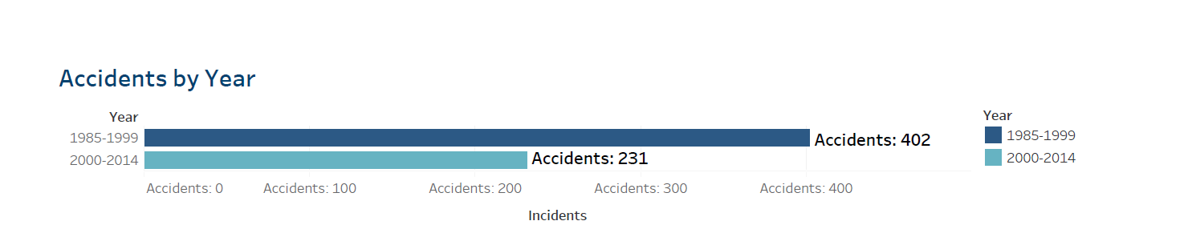
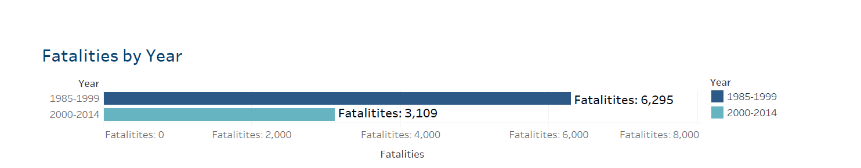
Airline Accident & Fatality Statistics

Slide 3
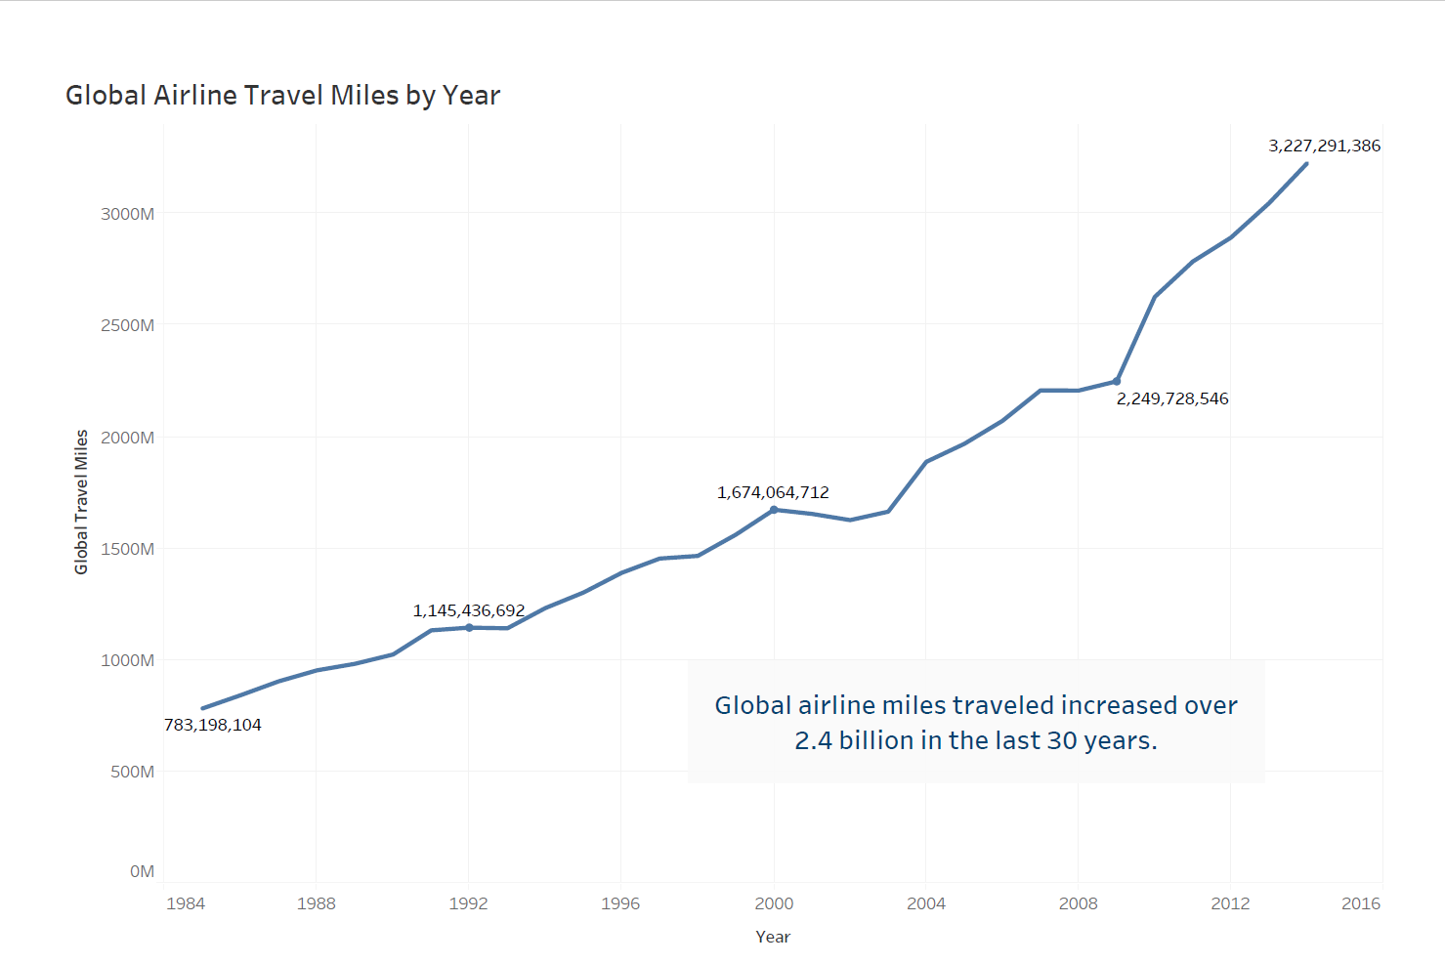
Airline Travel is Increasing

Slide 4
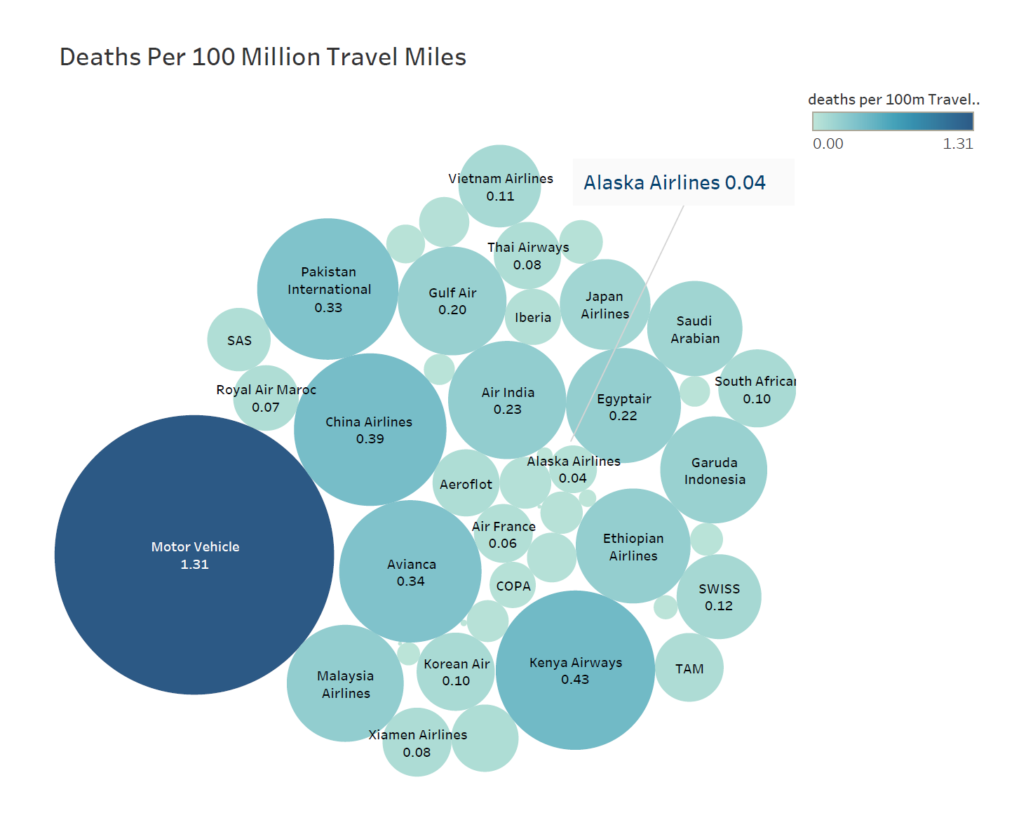
Fatality Rates by Airline vs Motor Vehicle

Slide 5
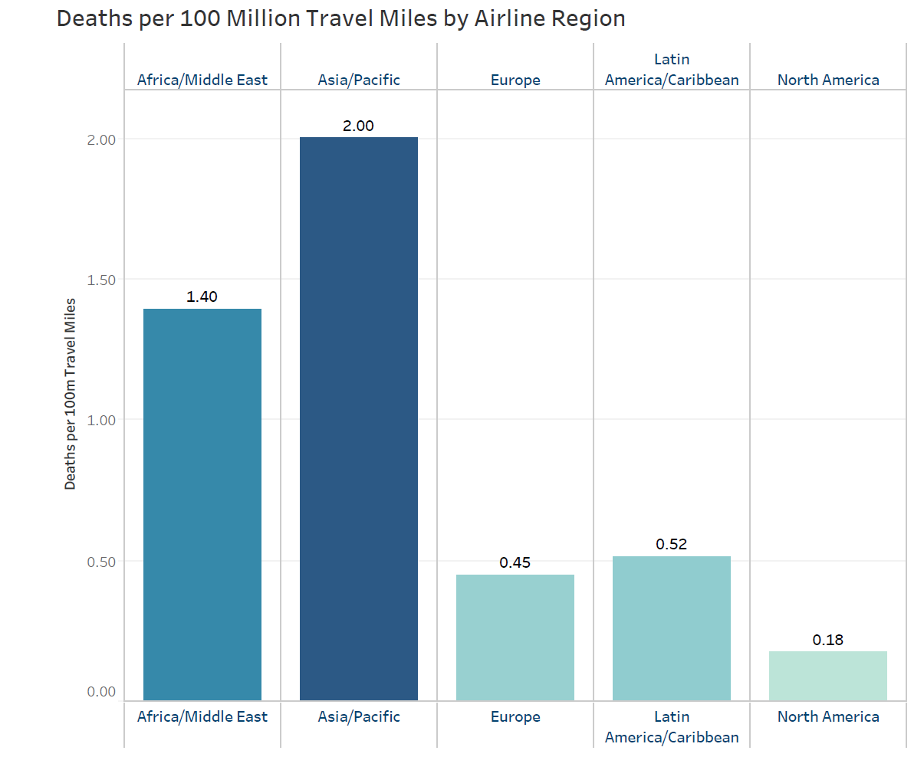
Airline Fatality Rates by Region

Slide 6
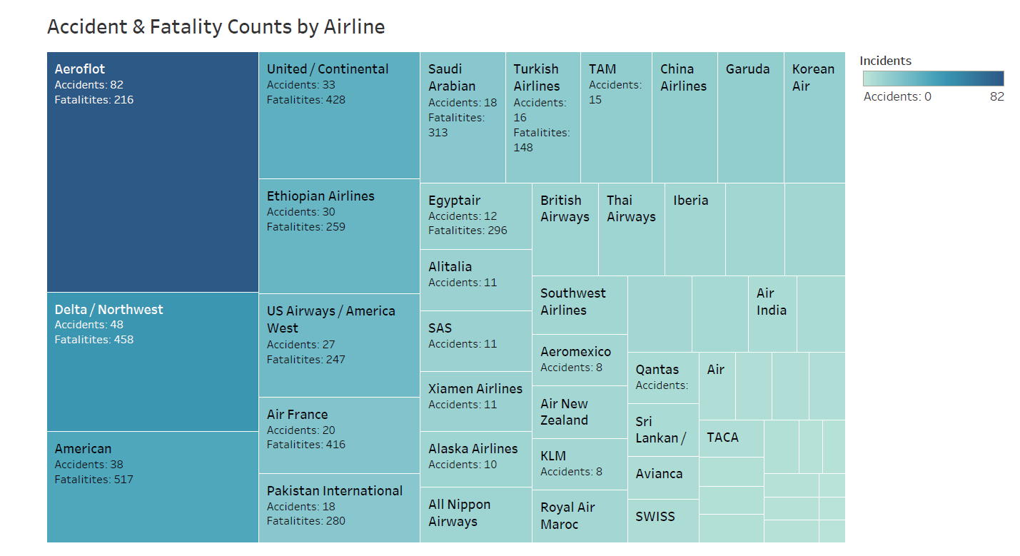
Airline Accident & Fatality Counts 1985-2014

Slide 7


2017 National Safety Council Census Data
1 in 103
1 in 188,364

Slide 8


